Slide 1




Introduction To Programming
Decision Structures
SoftUni Team
Technical Trainers
Software University
http://softuni.bg

Slide 2

Table Of Contents
What are decision structures?
What are boolean expressions?
Different types of decision structures:
if
if / else / else if
switch
Nested decision structures

Slide 3
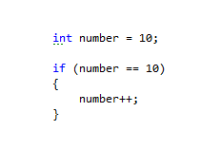
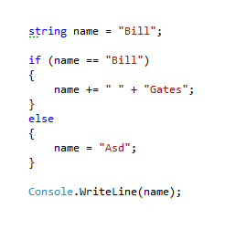
What are Decision Structures?
Decision structures introduce decision-making ability into a program
helps the program achieve flexibility than just a linear execution allows
enable you to branch to different sections of the code depending on the truth value of a Boolean expression

Slide 4

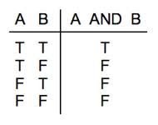
What are Boolean Expressions?
A Boolean expression is a logical statement which’s value is either TRUE or FALSE
Boolean expressions can compare data of any type as long as both parts of the expression have the same basic data type

Slide 5
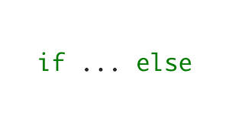
IF / ELSE / ELSE IF

Slide 6
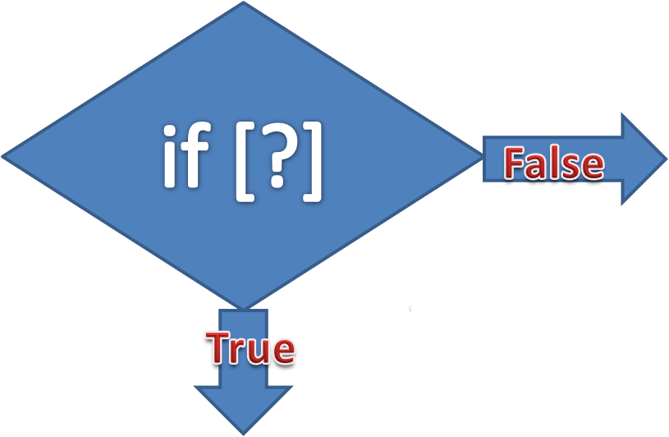
The IF statement
The if statement will execute a given sequence of statements only if the corresponding Boolean expression evaluates to true
int number = 10;
if (number == 10) {
Console.WriteLine(“The number is 10”);
}

Slide 7
If Statement Example
This is a simple representation of the IF statement
False
START
X = 10
Y = 21
X > Y
True
OUTPUT “X is > Y”
STOP

Slide 8
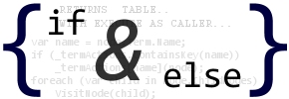
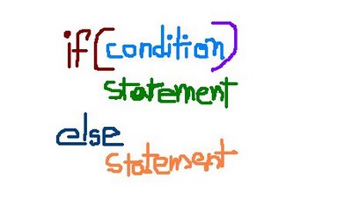
IF / ELSE Statement
The if / else statement allows the program to perform one action if the evaluates to true and a different action if it evaluates to false
int number = 10;
if (number == 10) {
Console.WriteLine(“The number is 10”);
}
else
{
Console.WriteLine(“The number is not 10”);
}

Slide 9
IF / ELSE Statement Example
This is a simple representation of the IF / ELSE statement
False
START
X = 10
Y = 21
X > Y
OUTPUT
“Y is >= X”
True
OUTPUT
“X is > Y”
STOP

Slide 10
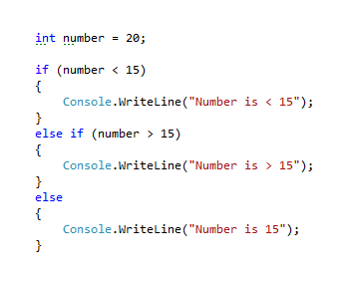
IF / ELSE IF Statement
The IF / ELSE IF statement allows you to check multiple expressions for TRUE value
If there is an ELSE block, it must be placed after all the ELSE IF blocks
The ELSE block will be executed only if all the other blocks fail

Slide 11
IF / ELSE IF Statement Example
This is a simple representation of the IF / ELSE IF statement
STOP
Output “n is < 10
Output “n is > 10
True
True
START
n = 10
n < 10
n > 10
Output “n is = 10
False
False

Slide 12
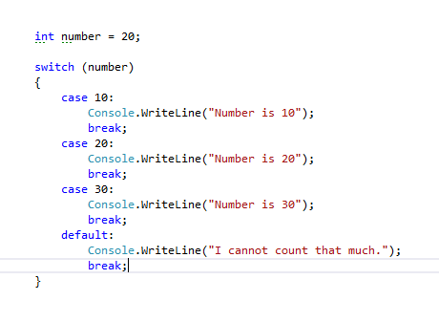
Switch Statement
The switch statement is a decision structure that allows multi-way branching
can simplify a complex combinations of if / else if / else statements
provides cleaner code, better structure and maintenance
allows the execution of a particular code for several cases which is known as fall trough

Slide 13
Switch Statement
switch – the opening statement
switch (variable) – the variable to test
case value – the case statement with the current checking value
break – the break statement which is put after every block to specify its end
default – the default case which will be executed if all other fail. This case is optional
string name = “Bill“;
switch (name)
{
case “Bill”:
Console.WriteLine(“Master Gates!”);
break;
case “Sam”:
Console.WriteLine(“Hi, Sam!”);
break;
case “John”:
Console.WriteLine(“Hi, John!”);
break;
default:
Console.WriteLine(“Hi, Person!”);
break;
}

Slide 14

Switch Statement
In the switch block, you can make fall through. In that case multiple cases can lead to one block of code
int number = 20;
switch (number)
{
case 10:
case 15:
case 20:
Console.WriteLine(“Number is <= 20”);
break;
default:
Console.WriteLine(“Number is > 20”);
break;
}
Fall through

Slide 15
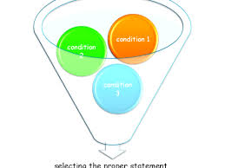
Nested Decision Structures
We can have nested decision structures. In other words – decision structures in the bodies of other decision structures
int number = 10;
if (number < 20)
{
Console.WriteLine(“Number is < 20”);
if (number > 15)
{
Console.WriteLine(“Number is > 15”);
}
else
{
Console.WriteLine(“Number is < 15”);
}
}

Slide 16

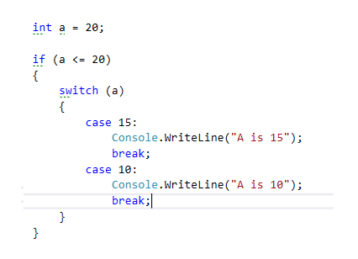
Live Demo

Slide 17

Summary
What are decision structures?
How to make a decision structure?
What are boolean expressions?
What types of decision structures are there?
Switch - Fall trough?
Nested decision structures?

Slide 18








Questions
https://softuni.bg/courses/javascript-applications/

